Slide 1


Data visualization Library for SPARQL Queries
THE UNIVERSITY OF DANANG
UNIVERSITY OF SCIENCE AND TECHNOLOGY
FACULTY OF ADVANCED SCIENCE AND TECHNOLOGY
Student: | Minh Huy DO - 123200103
Class: | 20PFIEV3
Academic advisor | Dr. Thi My Hanh LE
Supervisor | Assoc. Prof., Dr. Aline MENIN
Da Nang, 25 / 06 / 2025
Notes:
Good morning everyone. Today, I am honored to present a project that bridges the power of data with the clarity of visual storytelling — a Data Visualization Library for SPARQL Queries.

Slide 2
Table of contents
01
02
03
04
05
Overview
Proposed Solution
Obtained Result
Demo
Conclusion
Notes:
The presentation will consist of 5 parts.

Slide 3
01
Overview

Slide 4



WIMMICS Team - INRIA
Notes:
Wimmics stands for Web-Instrumented huMan-Machine Interactions, Communities, and Semantics. It is a joint research team between Inria Centre at University Cote D’Azur and I3S in Sophia Antipolis, French. This team connects formal and social semantics on the web, focusing on knowledge graph representation and reasoning to support online communities, their interactions, and resource management.

Slide 5


Overview
States of the art
Project Objective
1
ECharts
Design and develop a library to simplify and enhance the creation of visualizations for SPARQL queries, making them accessible to semantic web experts and decision makers without the need for advanced programming skills.
LDViz
2
VOWL, Encodable,…
3
Notes:
Right now, I want to say a little bit about the motivation of this project:
Recently, there has been a growing need for reusable and customizable data visualizations, especially in areas like Linked Data, the Semantic Web.
There are a few tools and research works that support data visualization, such as ECharts, D3.js, MGExplorer/LDViz, and VOWL(Visualization of Ontologies Web Language).
However, they still have many limitations, including:
Lack of direct support for RDF or SPARQL, requiring advanced programming and also Limited customization and chart diversity.
The goal of this project is to design and develop a lightweight visualization library that simplifies the creation of interactive visualizations from SPARQL query results. Make data visualization more accessible, customizable, and reusable, especially for people who may not have advanced programming skills. The library helps bridge the gap between complex linked data and user-friendly visual interfaces.

Slide 6
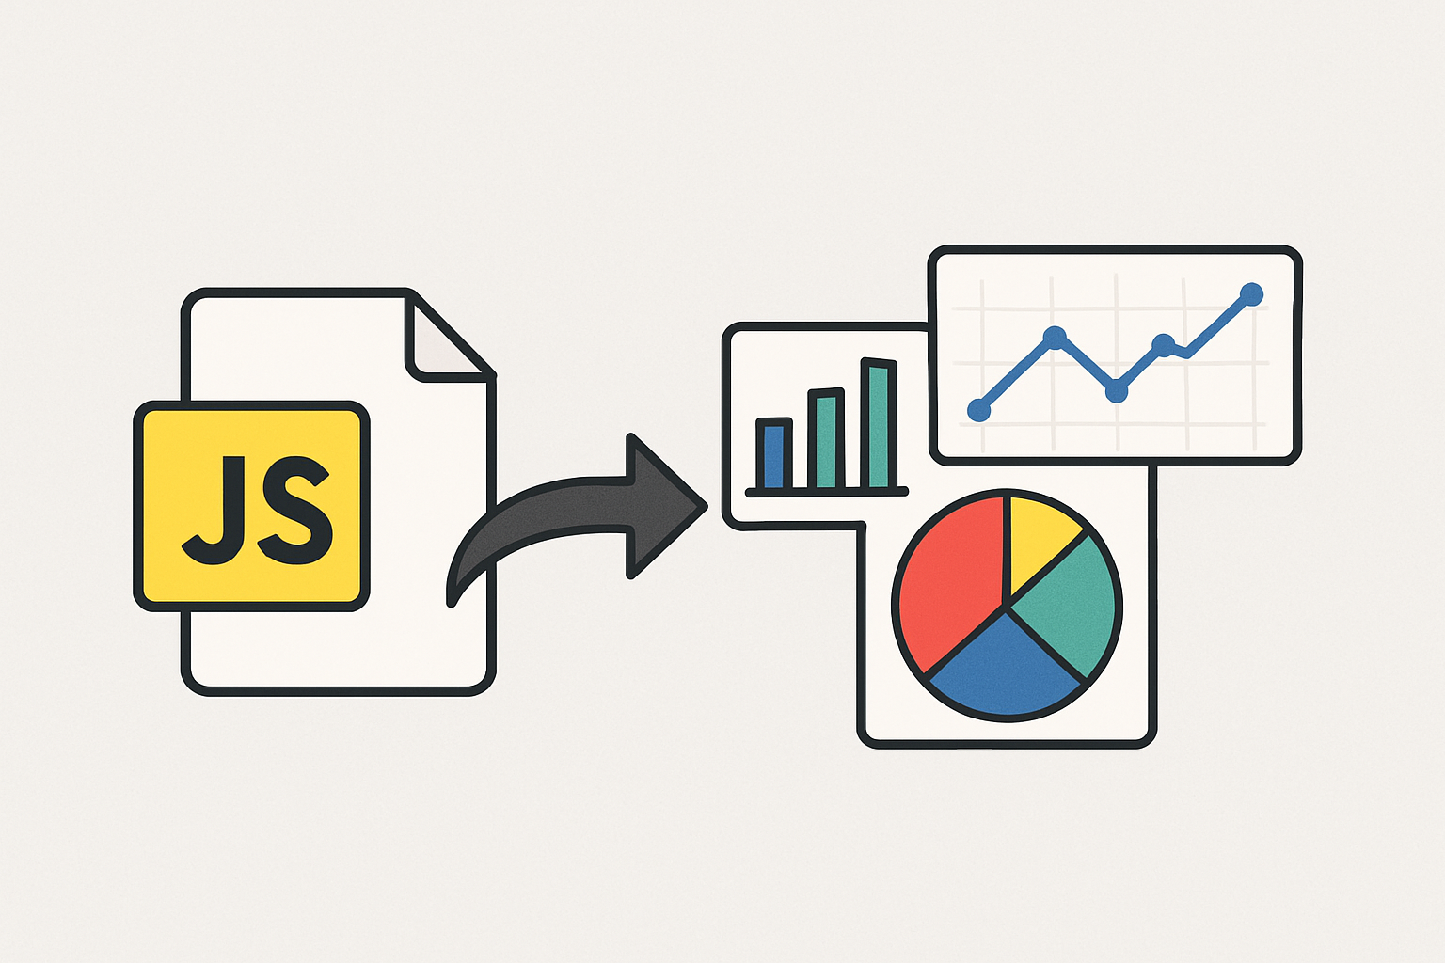
02
Proposed Solution
Notes:
With the limitations of existing tools, this project proposes a JavaScript visualization library that enables users to create interactive, reusable charts from SPARQL results

Slide 7
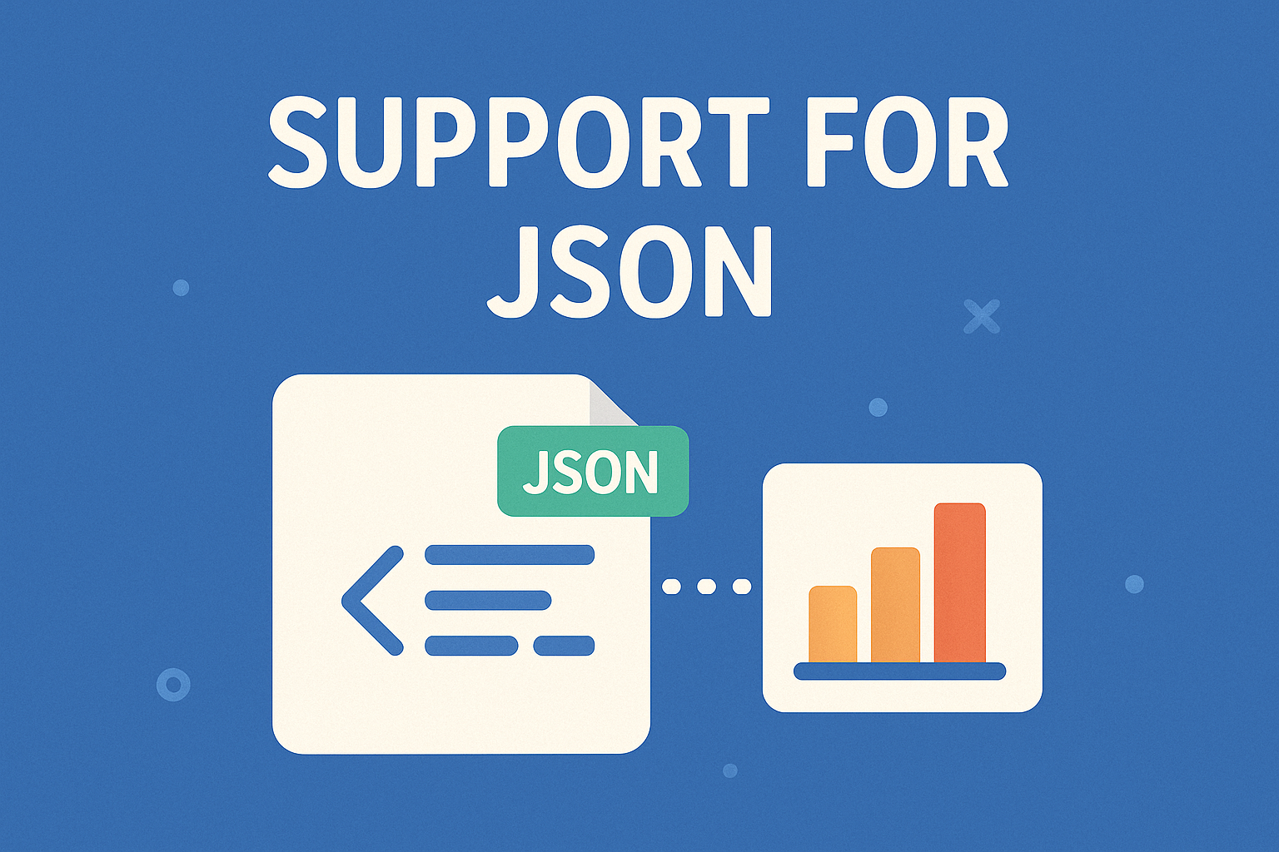


Core Technologies
JSON-based
SPARQL Result
Vega-Lite Customization
Web Component Scalability
Focus on standardized JSON format for SPARQL query results.
Utilize Vega-Lite grammar for flexible, declarative chart customization.
Use Web Components for strong packaging, and high performance and reusability.
Notes:
The solution is designed to be both powerful and accessible.
The library works with SPARQL query results, focuses on JSON format.
Users can easily customize visualizations using Vega-Lite grammar, a high-level declarative language for creating interactive and expressive visualizations.
Built with native Web Components for high performance and scalability. This ensures reusability, style isolation, and smooth performance in any web environment.
RDF represents data as triples, forming a graph structure. SPARQL is the standard query language for RDF data.
Declarative languages for defining interactive visualizations in JSON. Vega-Lite simplifies common tasks.
Encapsulated, reusable UI components using native web technologies. Ensures framework independence and high performance.

Slide 8
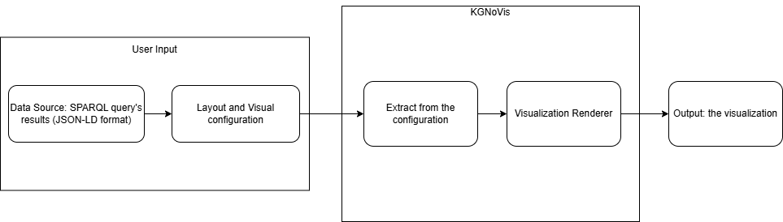
Block diagram of System
The system follows a 5-step process: User Input, Layout and Visual Configuration, Extraction from Configuration, Visualization Renderer, and Output. This design ensures adaptability and high customization.
Notes:
The system is built with a 5-step pipeline to transform SPARQL data into visualizations:
🔍 User Input (SPARQL Query / RDF Upload)
Users can enter SPARQL queries’s result or upload RDF (JSON-LD) files standardized in the JSON format for the input.
🧱 Layout & Visual Configuration
Users create the configuration in the Vega-Lite format and map data fields to visual configuration (x, y, color, etc.).
📦 Configuration Extraction
The system extracts relevant data fields from the configuration. Converts the mapping to Vega-Lite format and checks data compatibility with chart types.
🎨 Visualization Renderer
After successful extraction, use those parameters for the visual renderer
💻 Output Display
The final interactive chart is shown in the web interface.

Slide 9
03
Obtained Result
Notes:
To better understand the library, we will go through some of the diagrams that have been implemented so far.

Slide 10
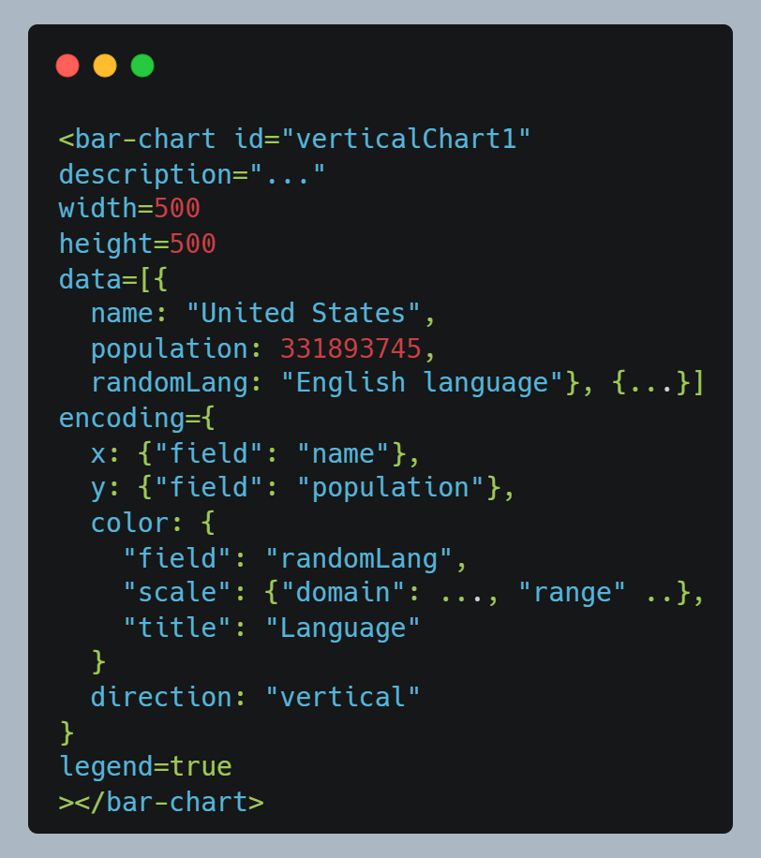
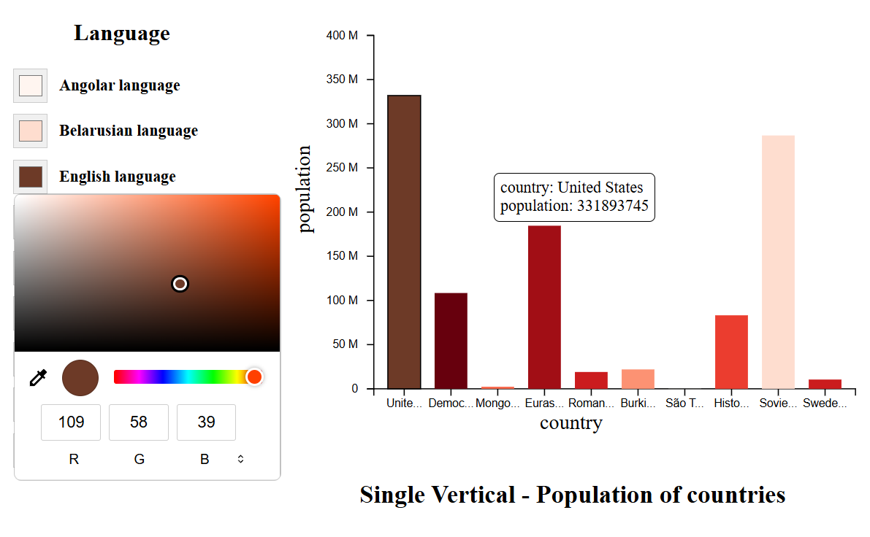
Bar Chart
Notes:
The first implemented component is the bar chart. We have 2 picture. On the left, we have the configuration for a custom <bar-chart> Web Component
The basic attributes are Width, height and description for the component
The “data” attribute is the array of objects. Each object in the array represents one data point.
The “encoding” specifies how data fields are mapped to visual properties:
Such as the “x” axis will be mapped to the field “name” in data
This chart is ideal for visualizing the one-to-one relationship between a categorical variable (x) and a quantitative value (y).
Allows changing the color of the bar via the “color” parameter of the “encoding” attribute
Supports both vertical and horizontal orientations via the “direction” parameter of the “encoding” attribute
Allows user to customize the rotation angle of the axis labels
Supports various types of numeric scaling for the y axis including: Linear Scale, Power Scale and Logarithmic Scale.
User interactivity: tooltip, interactive legend

Slide 11
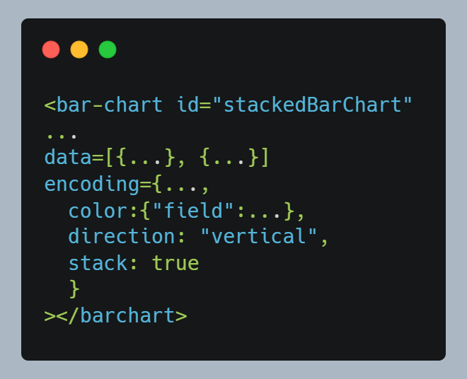
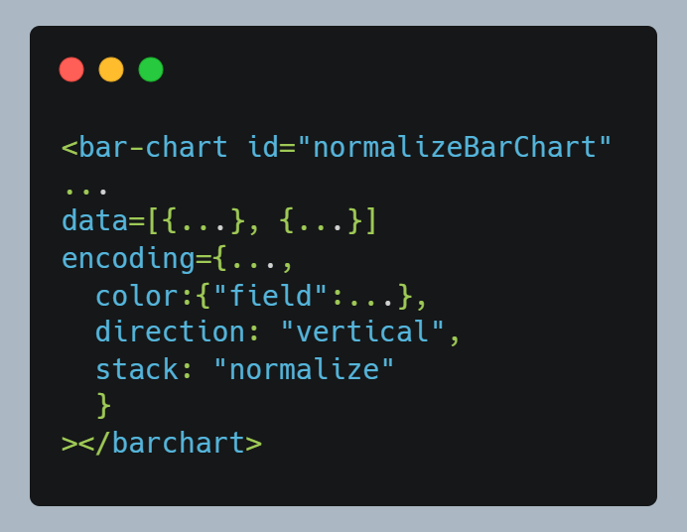
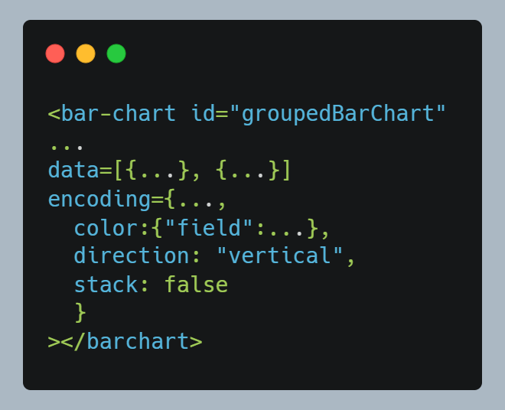
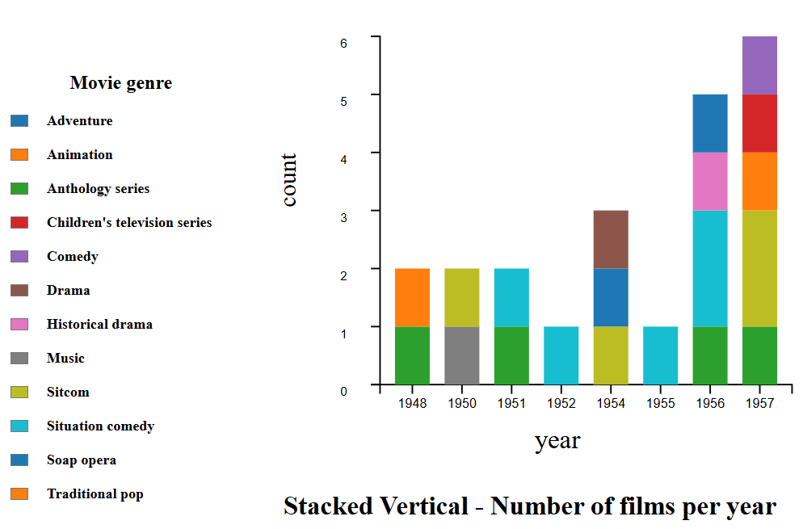
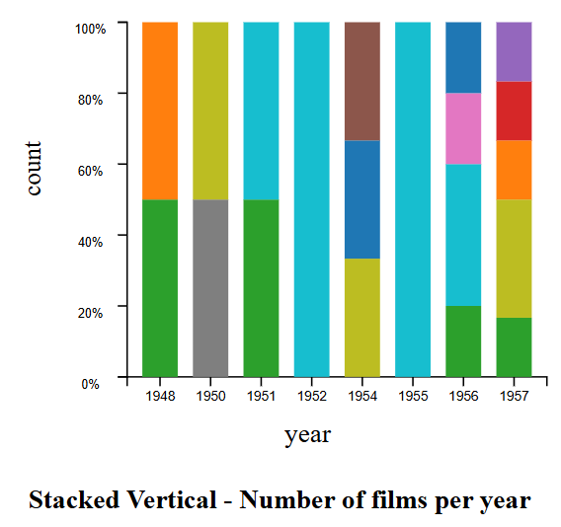
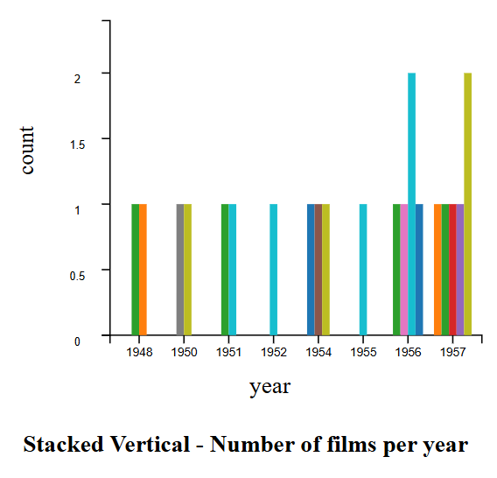
Subtypes of Bar Chart
Notes:
Compared to Vega-Lite grammar which is generating each component separately, this library is generating a common component and the mapping across different cases will only require a small difference in a certain parameter.
In the slide, you can see 3 subtypes of bar chart. In vega-lite the configuration between each other is very different, but in my library, the only different attribute is the stack in the encoding
This improvement makes the formatting difference between charts very little, creating a habit for the user.

Slide 12
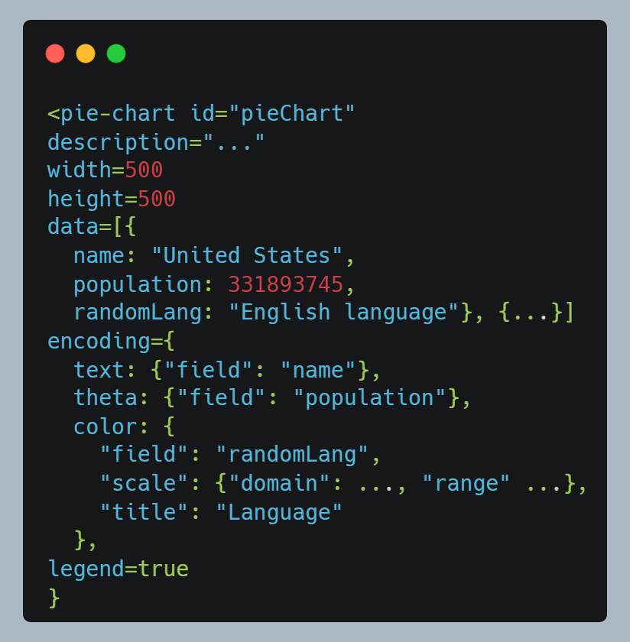
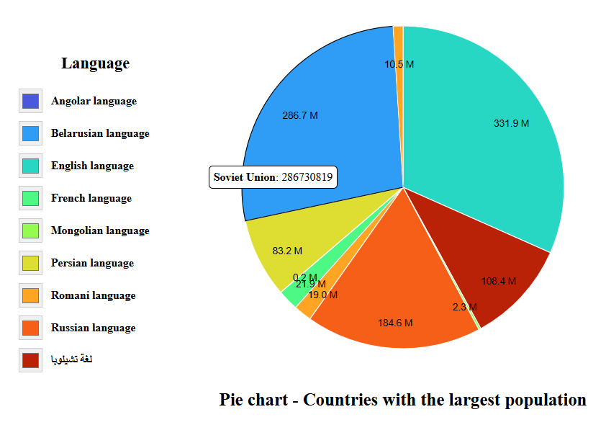
Pie Chart
Notes:
The second implemented component is the basic pie chart. We have 2 picture. On the left, we have the configuration for a custom <pie-chart> Web Component
The pie chart component is also no different in basic properties. The difference from the bar chart is that the pie chart will use theta, text properties instead of x and y in the encoding.
Especially the theta property is required for pie charts, it will determine the angular size (arc) of each slice.
Each slice of the pie represents a category and its relative value compared to the whole. Some required parameters:
The "text“ parameter in the “encoding” attribute: represents the name or category corresponding to each section of the pie chart.
The "theta": Represents the quantitative value for each category, which determines the angular size (arc) of each slice.
The "color": Used to assign different colors to each slice, enhancing distinction and readability between categories.
User Interactive: Tooltip and legend control.

Slide 13
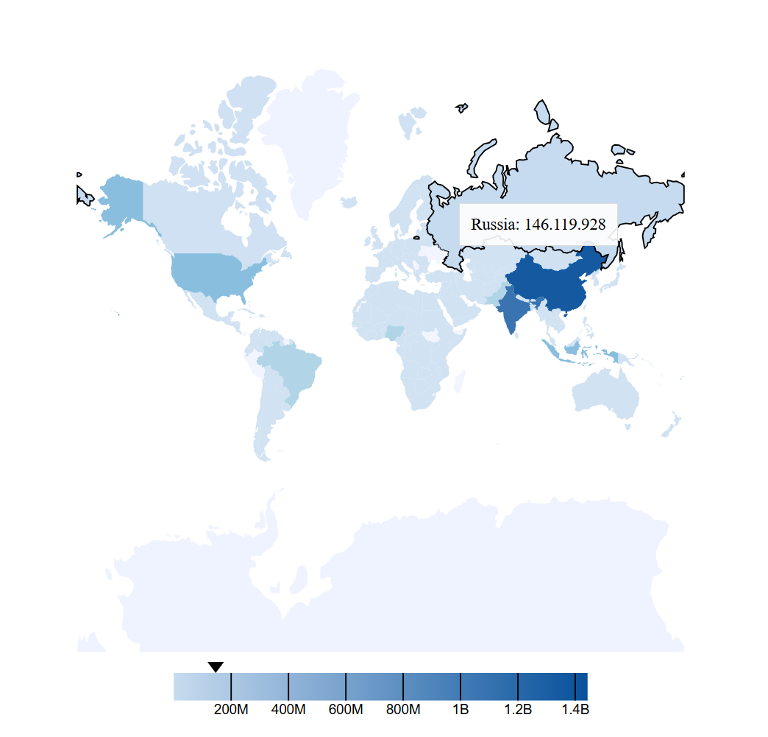
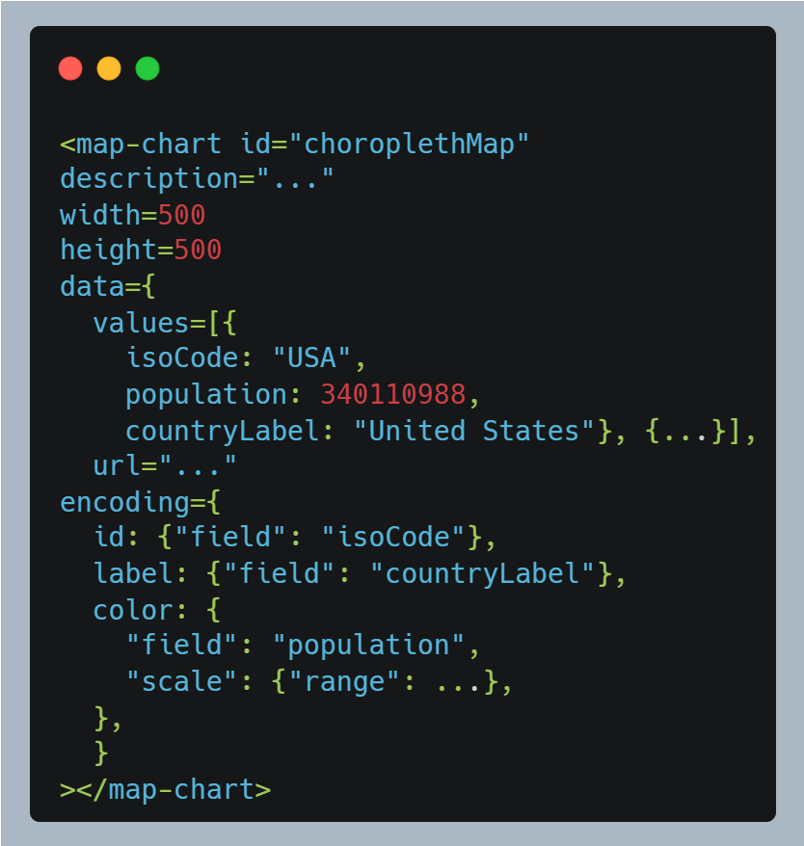
Geographic Map
Notes:
The last component is the geographic Map. Here is the example for the choroplethMap with 2 pictures: left is configuration and right is the visualization.
The data is including 2 things: values is the SPARQL query’s result and url is the geoJson file to draw the boundaries of the map.
The “id” is used for matching the values and the url. “label” is optional.
“color” will be used to color based on the field from the data

Slide 14
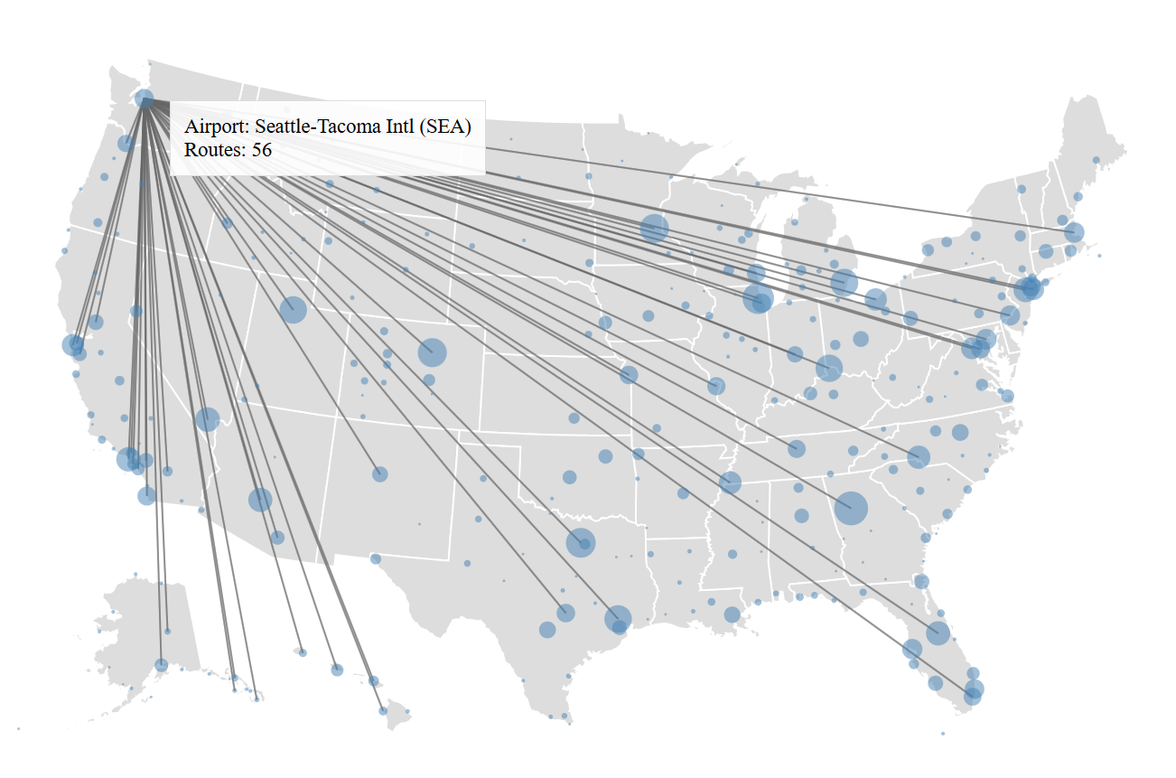
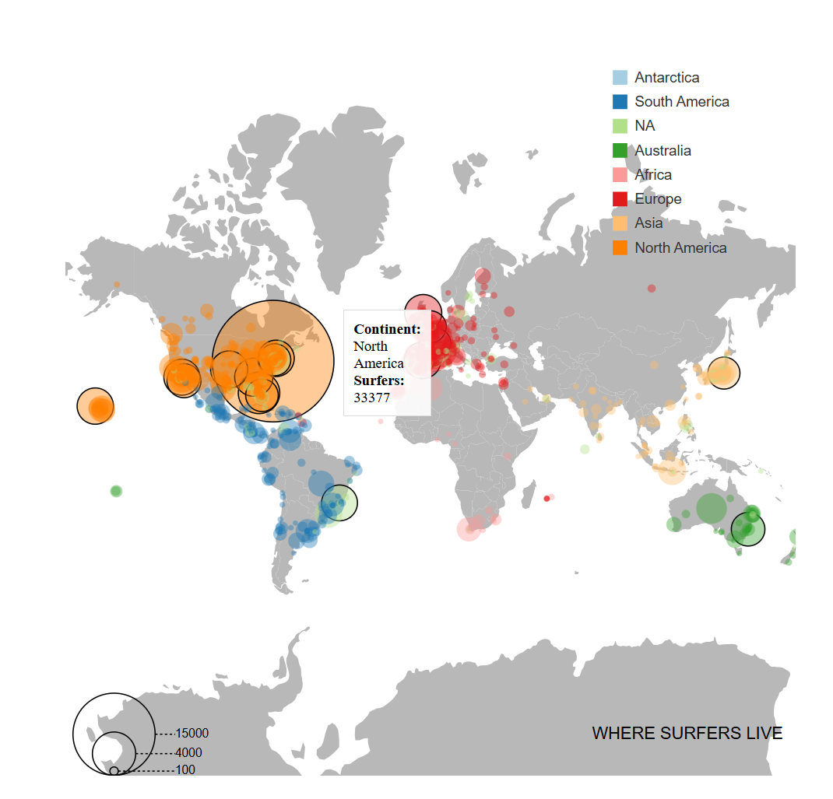
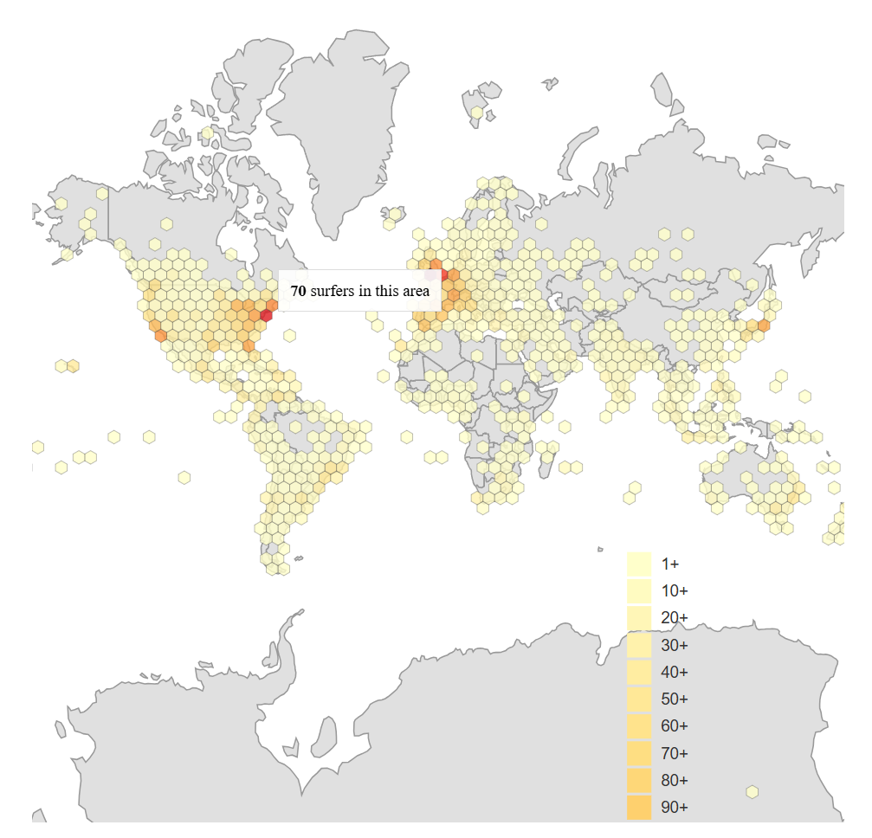
Subtypes of Map Chart
Notes:
In addition to the choropleth map, here are some map charts that the library is providing. Include connection map, bubble map and hexbin map.

Slide 15
04
Demo

Slide 16
05
Conclusion

Slide 17




Conclusion
Modular Chart Library
Developed various bar charts, pie charts, and map types using Vega-Lite.
Customizable System
Implemented flexible configurations for colors, axes, and stacking behaviors.
Library
Semantic Integration
Supports SPARQL query results and RDF-based data in JSON format.
NPM Publication
Reusable components published for community access and feedback.
Notes:
Development of a modular chart component library based on Vega-Lite,
Implementation of a fully customizable chart configuration system
Support for semantic integration via SPARQL query results and RDF-based data in JSON format, enhancing the components' usability in semantic web contexts.
Publishing reusable components to NPM for community access and feedback, demonstrating practical applicability and extensibility.

Slide 18
THANKS

Slide 19
Motivation: Bridging the Visualization gap
Increase Demand
Growing need for reusable, customizable data visualizations, especially for Linked Data and Semantic Web.
Technical Challenges
Existing libraries lack semantic compatibility and seamless integration with web components.
Project Goal
Develop lightweight, customizable chart components for various web platforms.

